Slide 1
Black Jack Application
By: Omer Farkhand and Sharek Khan

Slide 2
Technologies Used
We used ASP.NET, as the framework for the web application.
HTML, JS and CSS for styling and formatting.
C# for all business classes and entities.
MSSQL for all database interactions.
Utilized MS Visual Studio as primary development environment

Slide 3
Feature List
Register – New players are required to register to start a new game of Blackjack, registration requires player information and a username and password. These credentials will play into application authorization.
Login – Registered players are required to authenticate themselves before the launch of a new game.
Game – Blackjack game itself, hit cards, make bets and hopefully win earnings.
Guide – Provides documentation on the game of Blackjack and how it was implemented in this web application. Also details how to interact with the web application.
Leaderboard – Keeps an updated list of active players, with their wins, losses, draws and win/loss ratio. Encourage players to better themselves to progress in the leaderboard.

Slide 4
Classes - Entities
Rank (string rankName) – Class that decides the rank of a card (E.g. 1, 4, K, A)
Suit () – Enum that carries values for Suit of a Card (E.g. Spades, Hearts)
Card ( Rank rank, Suit suit, string imgPath ) – Class creates a card with a rank, suit and path to a saved image to represent that specific card
Deck () – Contains a list of Cards, initializes 52 Cards on instantiation
Player (string userName, string firstName, string lastName, string email, string b64Pssword, string b64Salt, int balance) – Class creates a player holding information that will help interact with the BlackJack game, Player also is a participant in the game
Dealer(string username, int balance) – Inherits Player class, is responsible for distributing Cards and opponent to compete with a player in BlackJack

Slide 5
Classes- Game Files
BlackJack (Deck deck, Dealer dealer, Player player) – Class caries all game logic and setup for the game of BlackJack, makes dealer distribute cards and allow player to participate
Game (string username, Result result, int winnings) – Class caries all information of a finished game, utilized for database interaction
Record (string username, int gamesPlayed, int wins, int losses, int draws) – Class caries information on all players and their progression in the app. Utilized for database interaction and leaderboard
Result () Enum that carries the different states of a players game as values (e.g. Won, Lost, Draw)

Slide 6
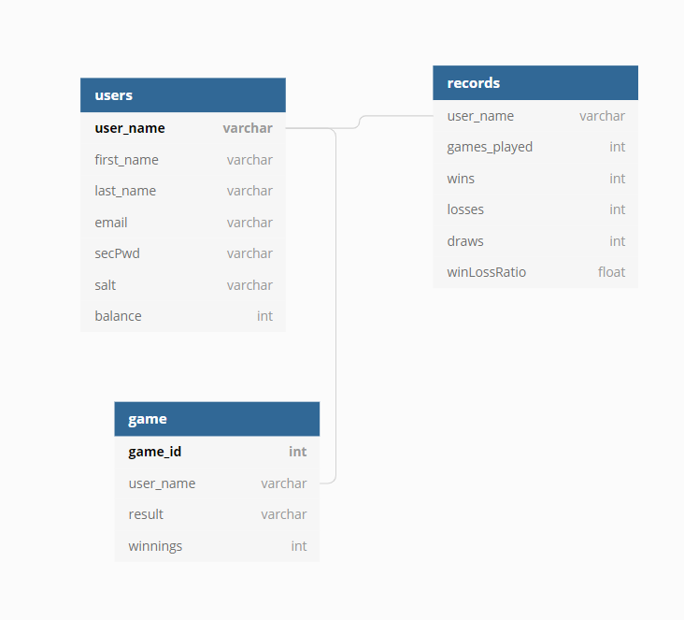
Database Diagram
user_name - Acts as primary key
- Unique to each user
user_name - Acts as foreign key, references Users
games_played - Tracks Users games played to completion
- Increments on each successive instance of game.
secPwd and salt
Store hashed encrypted strings
Utilized for authentication
winnings
- Unlike balance, this will display amount earned within a game
balance
- Holds overall balance of user
winLossRatio - Calculated field that relies on Users wins and losses
- Divides wins over losses to find a ratio
game_id
Auto increments
Acts as primary key for each game played
user_name - Acts as foreign key, references Users

Slide 7
Limitations
Time restraints, decided on some cool functionality that wasn’t implemented due to requirement to meet specific milestone deadlines.
Understanding certain concepts, a good time was spent trying to work around a stateless model, having to utilize state management to not lose data through new requests.
Designing on a web can be a limitation as structured design takes patience and A LOT of CSS.
Application lacks guest play functionality, not able to play without successful authentication.
Certain Blackjack functionality like Split was not able to be implemented.
Application does not allow more than one active player.
Players cannot add more to balance once depleted.

Slide 8
Scope for future enhancements
Add full BlackJack game functionality with all rules and move-sets possible.
Add a difficulty/stakes system where higher bets result in spiked difficulties and smarter A.I on dealers end.
We would like to try and implement local/online multiplayer support.
Implement an in game currency where players could acquire more in-game money.
Maybe provide a mobile port, gamble on the go.
Not really a feature set but provide better polishing/refinement of application. No one likes bugs…

Slide 9
Roles
Sharek:
Logic Implementation
Business Classes
DAO
Entities
Omer:
GUI
Business Classes
DAO
Entities

Slide 10
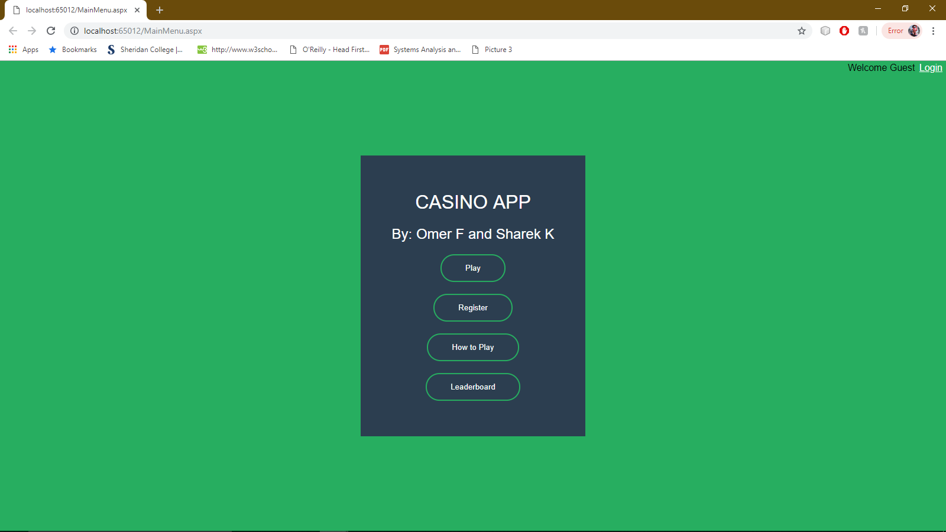
Web Application Demonstration

